Slide 1
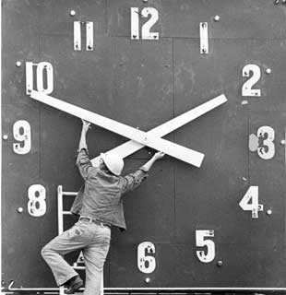


Prepositions of Time & Place:
In, On, & At
Writing in the Disciplines (WID)
G. Griggs & B. Morales
CiViS

Slide 2
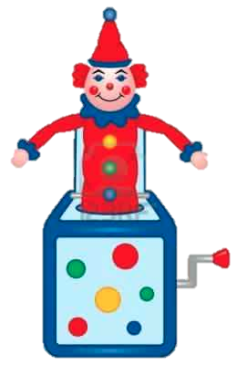
What are
Prepositions?
Jack is
in the box.
Prepositions link nouns and pronouns to objects in a sentence and always introduce a prepositional phrase [preposition ➔ object]
María was [at the doctor’s office.]
[On Friday,] Jorge was [in San Juan.]

Slide 3
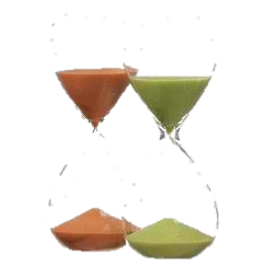
Prepositions
of Time
AT | IN | ON
Specific clock times, mealtimes: noon, night, midnight, breakfast, lunch dinner 8:00, 7:30, 1:15, 10:30 | Nonspecific times in a day, month, season, or year | Specific Days or Dates: M-T-W-Th-F-Sat-Sun

Slide 4
Practice: Prepositions of Time
AT | IN | ON
Specific: times, mealtimes | Nonspecific: Seasons, years, months, parts of day, period of time | Specific: days and dates
I drink a glass of warm milk to help me sleep (at, in, on) night.
Her birthday is (at, in, on) April 21st.
The air is very cool (at, in, on) the winter.
He will go to the mall (at, in, on) three hours.
The exam is (at, in, on) 3:00 pm.
The weather is warm (at, in, on) the fall season.
We will be at Longhorn Restaurant (at, in, on) Sunday (at, in, on) lunchtime.
Carlos will travel to Miami (at, in, on) July.

Slide 5
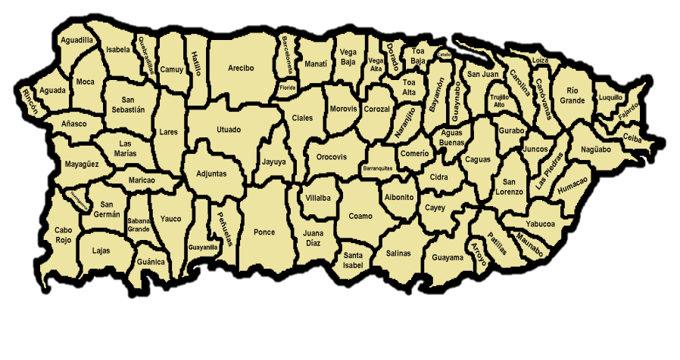
Prepositions
of Place
AT | IN | ON
Specific addresses: at 55 Sol Street in San Germán | Names of land areas: towns, counties, countries, states, continents – He lives in Rincón, Puerto Rico. | Names of streets & avenues: on Luna Street

Slide 6
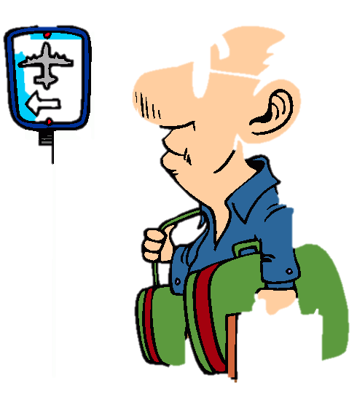
Prepositions
of Place
AT | IN | ON
General locations or points in space: the corner, airport, restaurant, bus stop, café | An enclosed space: room, garden, house, water, bag, purse, wallet | A surface: table, desk, board, ceiling, floor, ground

Slide 7

Prepositions
of Place
AT | IN | ON
A meeting place, event, or target: party, movies, conference, village, intersection | Print medium: book, magazine, newspaper | A general vicinity, electronic medium: coast, river, road, small island, beach, left, right, television, Internet, radio

Slide 8
Practice: Prepositions of place
AT | IN | ON
Addresses, general locations, points in space, meeting places, events | Names of land areas, enclosed spaces, print mediums | Names of streets, surfaces, general vicinities, an electronic medium
The party is (at, in, on) Rogelio’s house.
He has a large dog (at, in, on) his house.
His house (at, in, on) the coast (at, in, on) Cabo Rojo.
On our trip, we stopped (at, in, on) Yabucoa.
He likes to surf (at, in, on) the Internet.
She waited (at, in, on) the bus stop for the trolley.
The cat is (at, in, on) the bed.
The article was (at, in, on) the newspaper.
There is a pen (at, in, on) my backpack.
There was a bug (at, in, on) the ceiling.

Slide 9
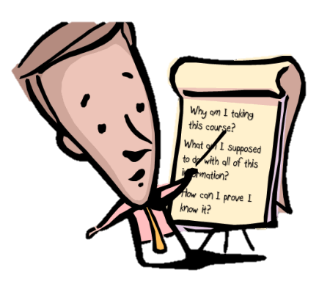
SUMMARY
At, on, and in are prepositions to show time and place
All prepositions link nouns and pronouns to objects and introduce prepositional phrases
There always are exceptions to the rules!
  We ride in a car but …. we ride on a bus, on a plane, on a train, and/or on a subway.

Slide 10

Images courtesy of the following Web sites
Beach ball – http://www.anthonyteacher.com/page/2/
Clock - http://www.etftrends.com/2010/09/time-short-gold-etfs/
Hour glasses - http://www.stephmodo.com/2007/08/hourglasses.html
Jack in the Box - http://www.123rf.com/photo_7821482_jack-in-the-box.html
Man at Airport - http://en.clipart-fr.com/search_clipart.php?keyword=airport
Map of Puerto Rico - http://mapsof.net/puerto_rico/static-maps/png/map-of-the-78-municipalities-of-puerto-rico
Person with list - http://www.articulate.com/rapid-elearning/the-3-essential-questions-every-learner-wants-answered/

